Slide 1

Property Risk AI Evaluation System
AI-Driven Architecture for Multi-Domain Risk Assessment
Legacy Risk Workflow Overhaul: Redesigned from a monolithic .NET MVC system to a modular, AI-first architecture to handle large, complex survey data efficiently.
Orchestrated AI Evaluation: Integrated OpenAI agents and n8n workflows to decouple risk assessment logic and enable parallel, domain-specific analysis.
Scalable and Maintainable: The new system supports asynchronous operations, reduced timeouts, and a maintainable structure aligned with modern software principles.
Photo by Hirsh Mohindra on Unsplash
Notes:
This presentation outlines the modernization of a legacy risk evaluation workflow using an AI-first architecture. The system originally lived inside an aging .NET MVC stack, which struggled with large survey payloads and multi-domain analyses. We redesigned it to be faster, modular, more maintainable, and aligned with modern operational patterns.
The new solution uses n8n as the orchestration engine, OpenAI agents for domain-specific analysis, and SQL Server as the durable storage layer. The goal was not to replace the existing application, but to expand its capabilities with a scalable and reliable AI-powered backend.
What you’ll see today is both a technical transformation and an operational evolution. The system is now capable of handling multi-domain risk evaluations in parallel, without blocking users or overloading the legacy application.

Slide 2




Executive Summary
Why We Modernized the Risk Evaluation Pipeline
Legacy Performance Bottlenecks
The MVC app struggled with large surveys and synchronous processing, creating delays and unreliability.
AI Integration Needed Structure
AI evaluations were failing due to oversized prompts and timeout constraints; parallelization was essential.
n8n Orchestration Introduced
A workflow engine was deployed to manage AI calls, batch processing, and asynchronous task handling.
Reliable and Scalable Output
With orchestration and decoupling, AI evaluations are now consistent, schema-compliant, and scalable.
Notes:
At the highest level, we had a workflow that was functionally correct but operationally fragile. The legacy MVC application was never intended to run heavy analytical workloads, especially not ones involving 100+ survey questions that needed AI evaluation.
Our modernization approach centered on decoupling analytics from user interactions. The MVC app now simply hands off data to n8n, which performs the analysis asynchronously through multiple smaller AI calls. This means users get fast responses while heavy lifting happens in the background.
The result is a solution that preserves the investment in the existing system while enhancing it with a robust, scalable AI evaluation engine that operates independently.

Slide 3
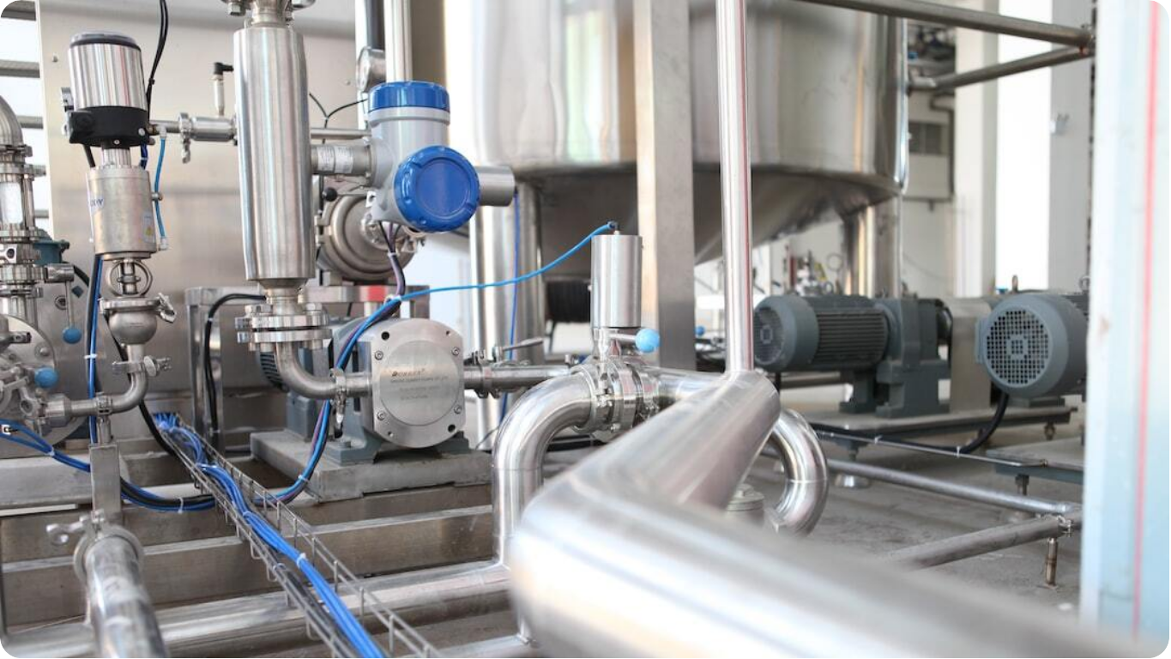
Problem Definition
The Core Challenges
Single-Threaded Processing: Legacy system executed entire survey analysis in one pass, blocking users and overloading resources.
Database Round Trips: User experience was poor because the amount of processing and database round trips became time consuming.
Computational Dependencies: Any changes to the questionnaire would require backend computational changes This made the system brittle .
User-Facing Failures: Any backend error surfaced directly to users, reducing trust and usability.
Photo by Crystal Kwok on Unsplash
Notes:
We began by mapping the problem from first principles. A 100-question survey spanning eight to ten risk domains creates a combinatorial burden when processed in one long synchronous operation. The legacy code read everything at once, tried to reason about it in a single pass, and returned results only when all work was complete.
The architecture forced everything into a “big batch” model, which AI models cannot reliably handle due to token constraints and timeout limits. A single prompt containing all domains produces unpredictable responses and frequent failures.
On top of that, the system tied analysis directly to user request cycles. Any delay, timeout, or exception manifested as a user-facing error. This was not sustainable.

Slide 4
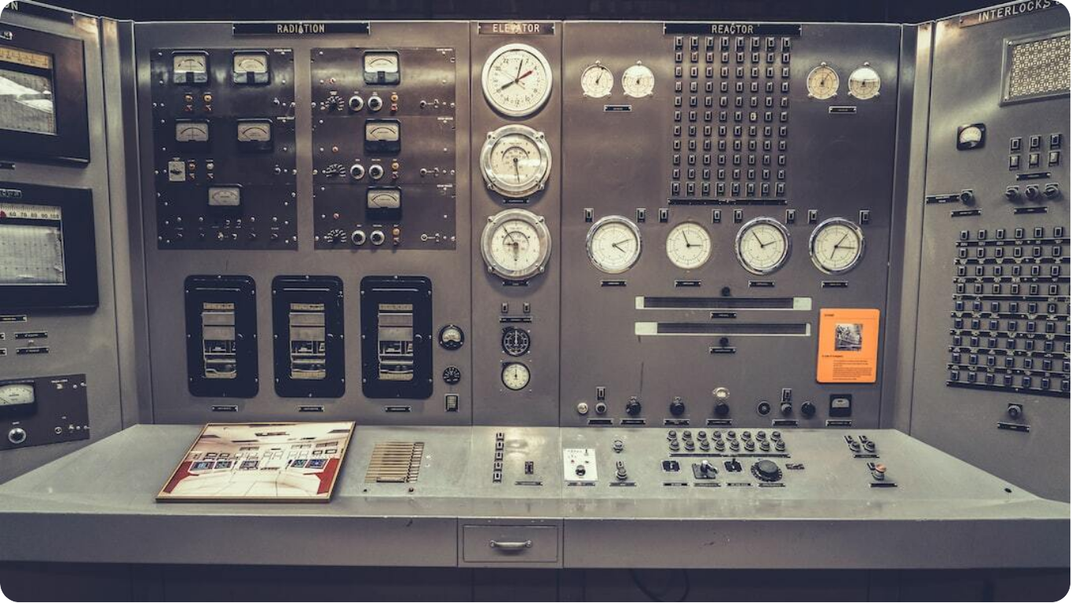
Constraints of the Legacy System
Why Fixing the Code Wasn’t Enough
Synchronous MVC Limitations:.NET 3.5 MVC lacked async capabilities, causing the UI to freeze during heavy operations.
Direct SQL Writes Blocked Requests: Data writes were part of the same cycle as user input, introducing potential delays and lockups.
No Background Execution Support: Absence of workers or task queues meant long-running tasks impacted overall performance.
Tight Coupling of Logic and UI: Business logic was hardcoded in the controller layer, making maintainability difficult.
Photo by Dan Meyers on Unsplash
Notes:
The legacy environment used .NET 3.5—stable, but without the async patterns or background processing tools available in newer frameworks. Any heavy operation performed within a controller caused delays, timeouts, or outright failures.
Additionally, the system wrote directly to SQL Server from the same request cycle. That meant any long-running operation could block the entire chain—controller, ORM, SQL session, or all of the above. This made the system brittle and complex to maintain.
These constraints pushed us toward an architectural separation rather than patching the existing code. The new architecture uses MVC only for request initiation and for displaying results, while n8n handles orchestration and AI analysis.

Slide 5

Solution Goals
What the New Architecture Needed to Achieve
Asynchronous Architecture: Decoupled AI analysis from the MVC layer to improve responsiveness and isolate computation.
Parallel Domain Processing: Each risk domain is analyzed independently, enabling efficient and scalable evaluation.
Reliable, Schema-Compliant Output: Introduced validation layers to ensure all AI responses produce structured JSON with strict compliance.
Minimal Legacy Disruption: Changes inside the MVC application were kept minimal, focusing modernization externally.
Photo by Taylor Vick on Unsplash
Notes:
We defined our goals with operational stability and minimal invasive change in mind. The legacy MVC system remains intact, with a very small enhancement: a call to n8n via webhook. Everything else—the logic, the analysis, and the data storage—lives externally.
Reliability drove most decisions. Splitting processing into discrete domain-specific AI calls was essential, as was schema enforcement. The system must always produce valid JSON, even if domain inputs vary.
Finally, we wanted a platform that was easy for a team to operate. n8n provides a visual, auditable workflow with logs, retries, and maintainable nodes.

Slide 6




AI-First Philosophy
How AI Shaped the Architecture
Focused Domain Reasoning
AI performs better when prompts are scoped to a specific domain with clear inputs and expectations.
Avoiding Overload Failures
Single, large AI prompts led to hallucinations, token overflow, and inconsistent results.
Batching + Schema Enforcement
Batched domain evaluations with strict schema outputs improved accuracy and downstream utility.
Delegated Intelligence
The orchestration layer (n8n) manages control flow, while AI handles targeted reasoning only.
Notes:
AI isn’t magic—it needs structure to perform well. We embraced a philosophy that AI should be used surgically rather than holistically. Each domain—Fire, Flood, Wildfire, Security, Continuity—gets its own prompt, its own input, and its own evaluation.
This dramatically reduces complexity. When AI only analyzes a slice of the data, its reasoning becomes clearer, more reliable, and easier to validate. We avoid hallucinations, reduce costs, and gain traceability.
Using n8n as the orchestration layer gives us control over sequencing, batching, retries, and schema validation. The AI becomes a component inside a well-defined pipeline rather than a black box.

Slide 7
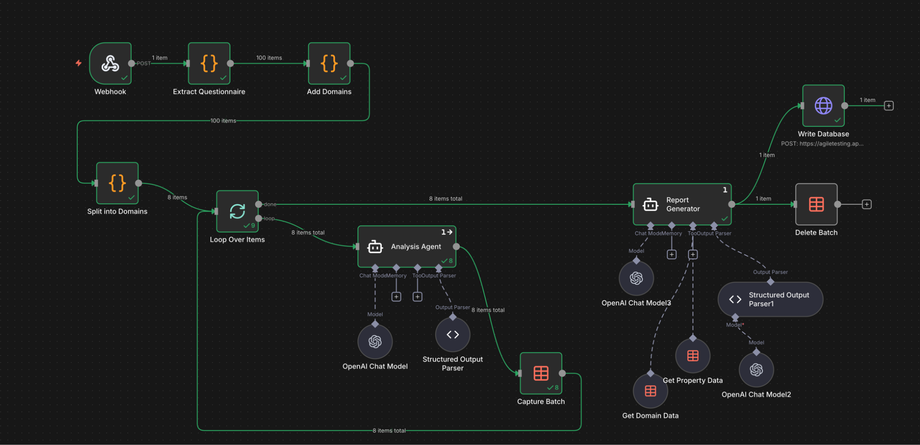
High-Level Architecture
From MVC to AI-Powered Processing
MVC Triggers n8n Webhook: Legacy MVC app initiates the process by posting raw survey JSON to an n8n webhook.
n8n Orchestrates Analysis: JSON is cleaned, grouped by domain, and sent through a loop to OpenAI agents for evaluation.
Results Merged and Stored: Processed outputs are merged into a final report and stored via a separate background workflow.
UI Renders Summary Only: MVC UI now simply renders the final risk assessment, offloading all analysis to the backend.
Notes:
The high-level flow is straightforward once decoupled. MVC posts raw survey JSON to n8n. n8n cleans it, organizes it, and then uses a “Loop Over Items” node to iterate through the domain sets. Each iteration sends a small prompt to an OpenAI Agent.
After all domains are processed, n8n merges them into a structured risk assessment that includes property summary, domain reports, and overall risk scoring. SQL writes happen in a secondary workflow to keep the primary pipeline fast.
MVC simply displays the returned JSON. This keeps the UI simple while the backend handles complexity.

Slide 8
Workflow 1 Overview
Webhook JSON → AI Analysis (Batch Mode)
Webhook Entry Point: User-submitted surveys are captured via a webhook, providing an API-like intake for varied JSON formats.
Survey Normalization: Unstructured input is cleaned, standardized, and reformatted into consistent question/answer pairs.
Domain Clustering: Questions are grouped by risk domain, forming batches for AI evaluation.
Parallel AI Calls: Each domain is independently analyzed by an OpenAI agent and results are compiled.
Merged Final Output: Domain responses are aggregated into one unified JSON report for downstream use.
Notes:
The first workflow handles the entire transformation pipeline. It begins with a webhook trigger receiving user-submitted surveys. These surveys vary in completeness, order, and structure, so normalization is the first step.
Once normalized, the system groups questions by domain. This clustering step is key because it defines how data flows through the AI agents. Each domain becomes a batch item.
After the domain agents return their analyses, n8n compiles them into the final unified JSON response used by the legacy application.

Slide 9




Workflow 2 Overview
Risk Evaluation JSON → SQL Writer
JSON Intake
Final AI-evaluated report is passed to a second workflow focused on storage.
Relational Preparation
Flattened and organized into structured formats compatible with SQL tables.
Multi-Table Inserts
Domain scores, weaknesses, and mitigation steps are stored in normalized relational tables.
Asynchronous Operation
Runs as a background task, isolating UI response times from database latency.
Notes:
The second workflow is intentionally decoupled. It serves as a background task to write results into SQL Server. This ensures MVC does not wait on database operations and avoids locking.
The workflow flattens nested structures—domains, weaknesses, mitigation steps—into relational tables. This makes the data useful for future dashboards or analytics.
By splitting writes into a dedicated workflow, we gain durability, retry logic, and operational isolation from user-facing functions.

Slide 10
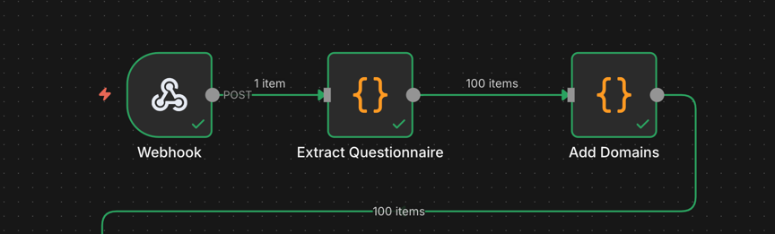
Node-Level Walkthrough
Primary Intake Point: Webhook acts as the gateway for receiving survey JSON from the MVC application.
Payload Validation: Immediately checks the JSON structure for syntactic correctness before workflow processing.
Async Pipeline Initiation: Transfers the data into n8n’s asynchronous processing sequence, decoupling UI delays. Security is protected by authentication (demo uses a username and password, production would use an API secret key
Notes:
The webhook acts as the new API gateway for survey intake. It accepts JSON of any size and provides immediate validation that the payload is syntactically correct. This node frees the MVC layer from handling long-running tasks.
Once the webhook receives data, it pushes the entire payload into the workflow for transformation. By making this the core entry point, we also gain logging, versioning, and usage tracking provided by n8n.
This separation is central to long-term flexibility: any system (not just MVC) can submit surveys through the webhook in the future.

Slide 11
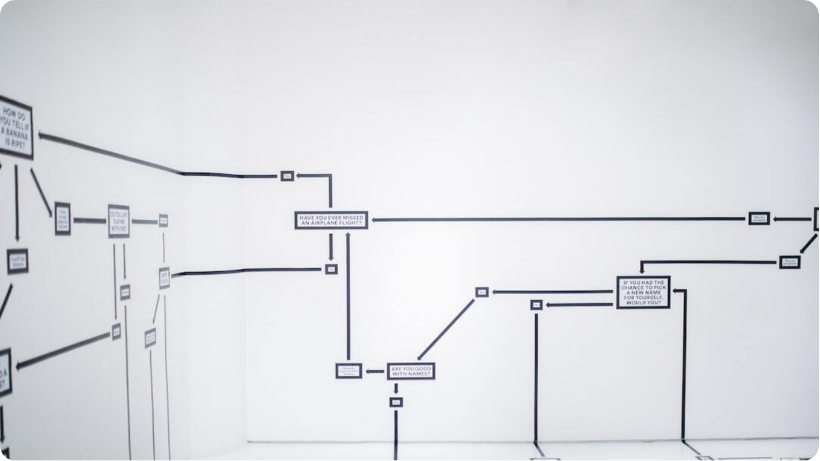
Database Model Overview
Storing Final Risk Results
Normalized SQL Structure: Final report is decomposed into multiple relational tables supporting full queryability.
Job-Level Indexing: Each submission is stored as a Job record with foreign key links to all domain entries.
Separate Domain & Mitigation Tables: Domains, weaknesses, and mitigation steps are split to enable structured analysis.
Analytics-Ready Design: Model supports trend tracking, dashboards, and cross-property analytics in BI tools.
Photo by Hanna Morris on Unsplash

Slide 12
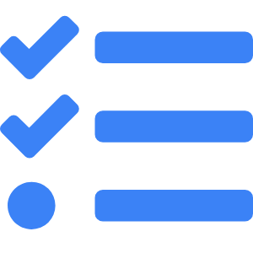



Operational Benefits
Why the New Architecture Works Better
Batch Processing
Domains are processed independently in a batch, improving speed and fault isolation.
Timeout-Free Execution
No monolithic prompts mean AI runs are shorter and more consistent.
Decoupled SQL Writes
Storage runs asynchronously, preserving UI responsiveness and eliminating bottlenecks.
Schema-Validated Outputs
All AI results are forced into a clean format, reducing parsing errors and manual corrections.
Notes:
The operational gains are extensive. The pipeline is now robust, predictable, and fast. Failures in one domain don’t affect others, and the system can scale with additional questions or new domains.
Workflow observability is a major upgrade. n8n provides node-level logs, retry capabilities, and error alerts. This environment is more maintainable and friendlier for team operations.
Just as importantly, developers can evolve the backend without touching the legacy application. This keeps modernization affordable.

Slide 13



Risks & Trade-Offs
What We Accept to Gain Scalability
AI Model Dependency
Reliance on OpenAI agents introduces external service risk and requires prompt maintenance.
Workflow Complexity in n8n
Centralized orchestration demands careful monitoring and ongoing tuning.
Eventual Consistency
Asynchronous writes may delay final database visibility, trading speed for isolation.
Rule Maintenance Burden
Domain classification logic must evolve with survey changes to preserve accuracy.
Notes:
No architecture is perfect. While we gain scalability and reliability, we also introduce new operational dependencies on n8n and OpenAI services. Proper monitoring and fallback plans are essential.
The system also becomes dependent on prompt stability. As domains evolve, grouping rules and AI instructions need periodic updates to stay aligned with business needs.

Slide 14




Future Enhancements
Where We Can Grow Next
Voice-Based Survey Intake
AI agents that clients can speak to for dynamic, real-time data collection.
AI-Driven Insurance Alignment
Models trained to compare risks against policy guidelines for coverage optimization.
Follow-Up Automation
System-generated clarifications and deeper analysis prompts for incomplete or risky responses.
Cross-Property Analytics
Pattern discovery across risk profiles to guide portfolio-level decisions and mitigation strategies.
Notes:
The current system serves as a foundation for much larger capabilities. Domain-specific AI can be expanded to cover policy recommendations or underwriting alignment.
We can also generate adaptive follow-up surveys, automatically building risk clarification questions based on deficiencies found. This turns the system into a proactive evaluator.
Finally, with the SQL dataset, we can build powerful analytics dashboards to visualize trends at scale.

Slide 15

Conclusion
A Stable, Scalable, AI-Powered Risk Platform
Legacy System Preserved: Modernization enhanced functionality without disrupting existing MVC workflows.
Modular AI Integration: Domain-specific AI agents support parallel processing and consistent evaluation.
Reliable and Responsive: Decoupled workflows reduce timeouts and maintain fast UI feedback.
Extensible and Maintainable: Architecture supports future domain additions and evolving business requirements.
Photo by Harpal Singh on Unsplash
Notes:
This architecture respects the investment in the legacy system while empowering it with a modern, scalable AI backend. The core application remains stable, and all heavy logic happens externally.
By splitting analysis into small, domain-specific tasks, we gain clear and reliable outputs while minimizing AI failures. This dramatically improves long-term sustainability and performance.
Most importantly, the system is now flexible. As new risks emerge or new domains need evaluation, the architecture supports growth without structural disruption.

